Slide 1
夥伴商店發展專題
Partner Stores Development
Marcus Chan
商業夥伴拓展經理
Affiliate Development Manager
本簡報中提到的收入等級純屬舉例說明，無意代表美安香港超連鎖™店主的一般收入，也無意表示任何超連鎖™店主皆可賺取同等收入。美安香港超連鎖™店主的成功與否，取決於其在發展事業時的努力、才能與投入程度。The income levels mentioned in the following presentation are for illustration purposes only. They are not intended to represent the income of a typical Market Hong Kong UnFranchise ™Owner, nor are they intended to represent that any given Independent UnFranchise ™ Owner will earn income in that amount. The success of any Market Hong Kong Independent UnFranchise ™ Owner will depend upon the amount of hard work, talent, and dedication which he or she devotes to building his or her Market Hong Kong Business.

Slide 2
HK.SHOP.COM
Partner Store

Slide 3
HK.SHOP.COM x Partner Store
Market Hong Kong
Preferred Customer
Partner Store
UFO

Slide 4
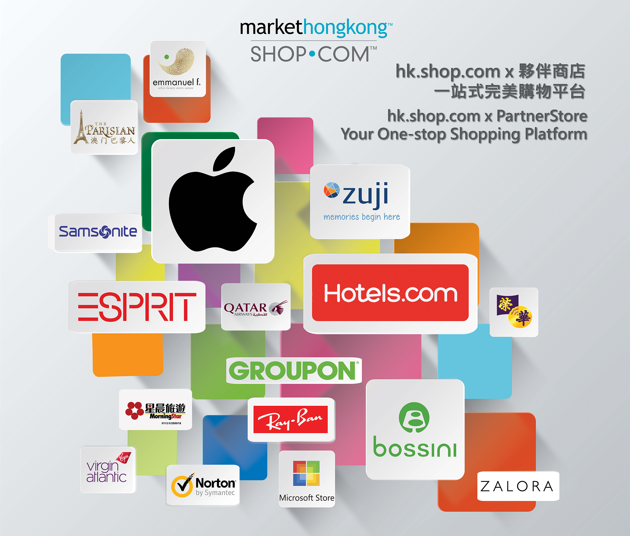

Slide 6
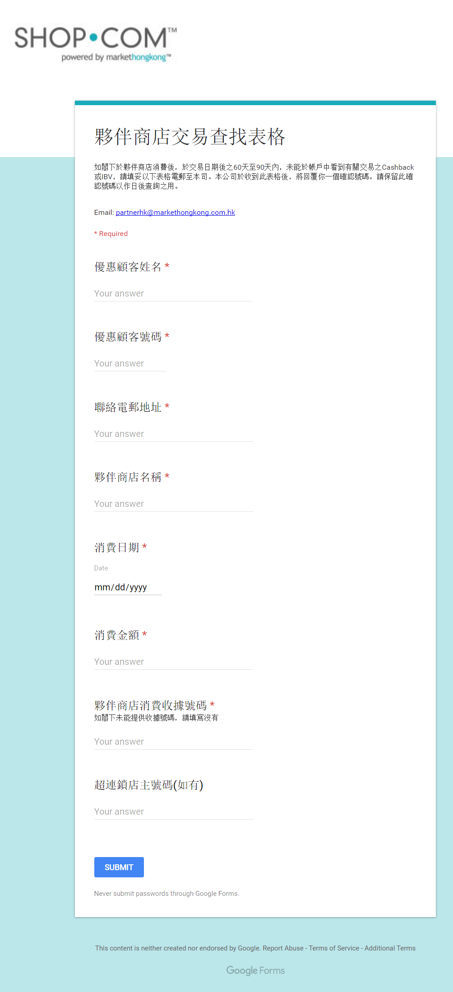
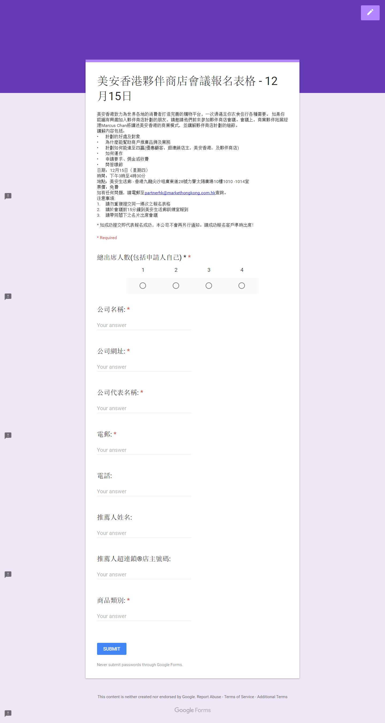
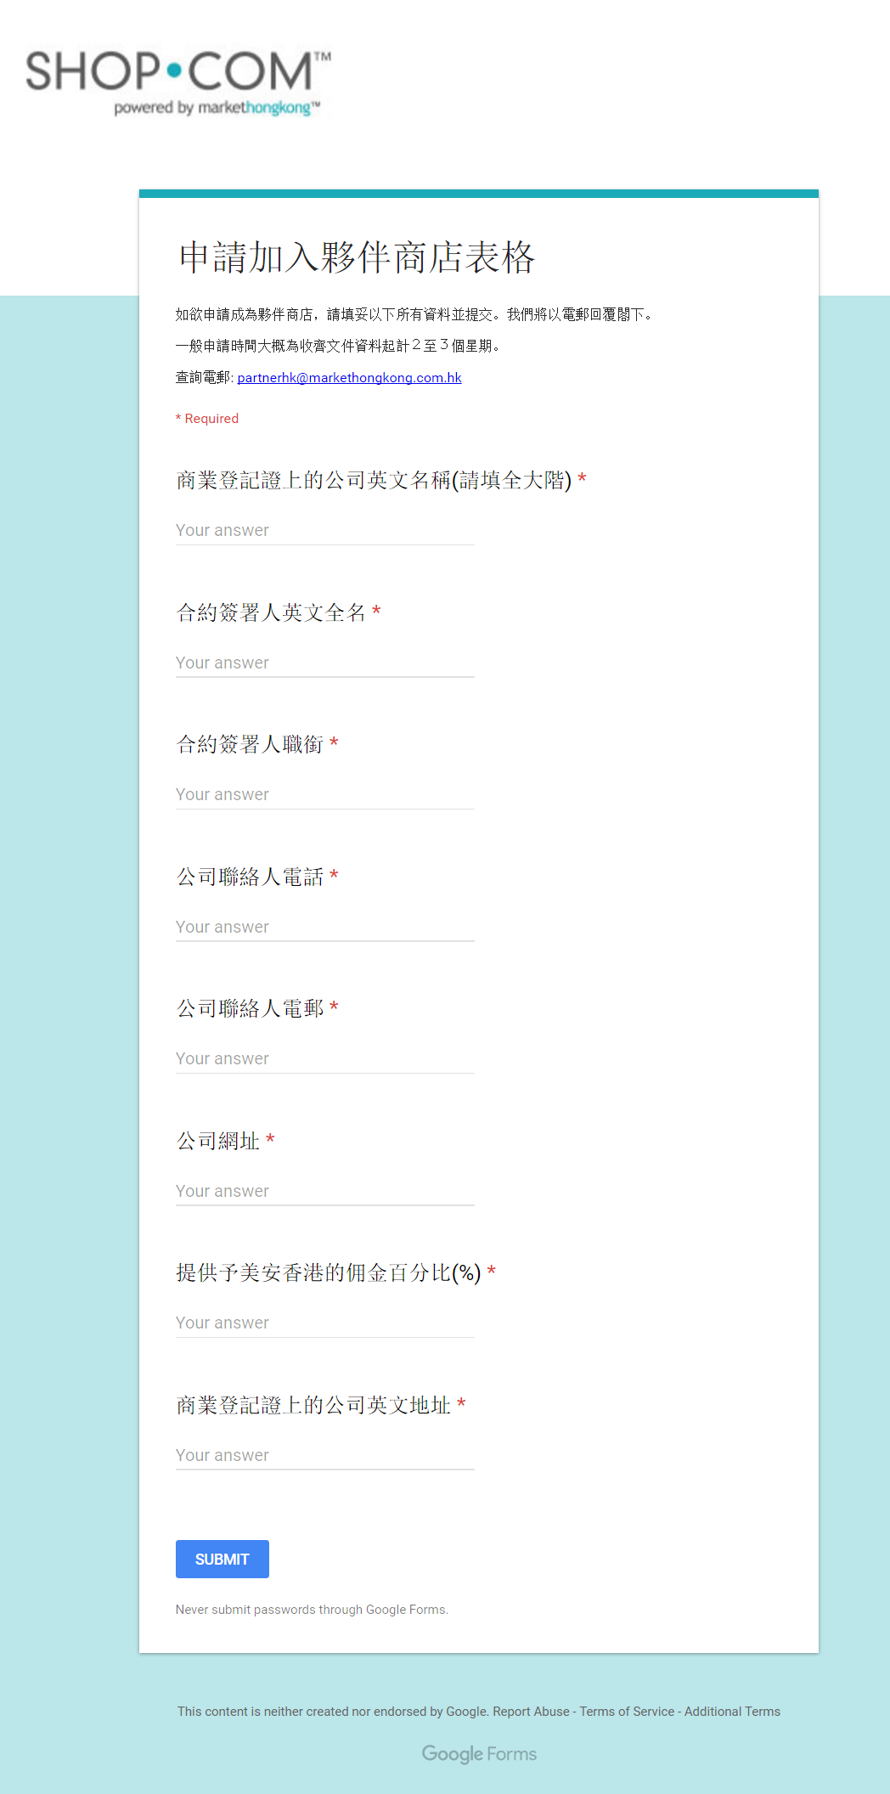
Changed to digital format
Order Tracking form
Partner Store Conference
Partner Store Application

Slide 7
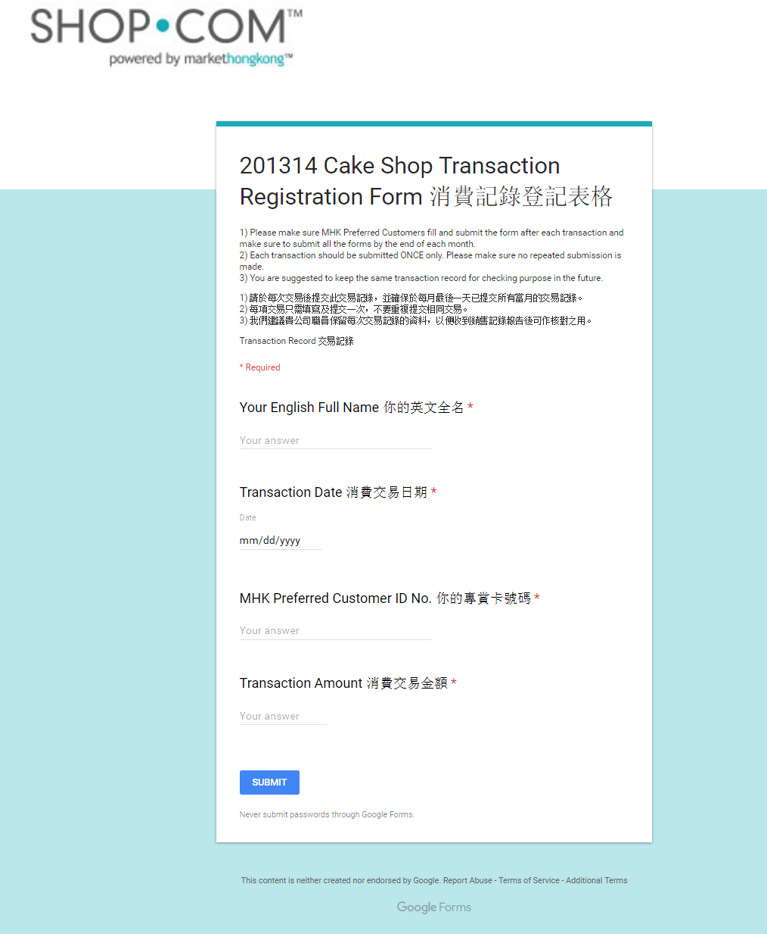
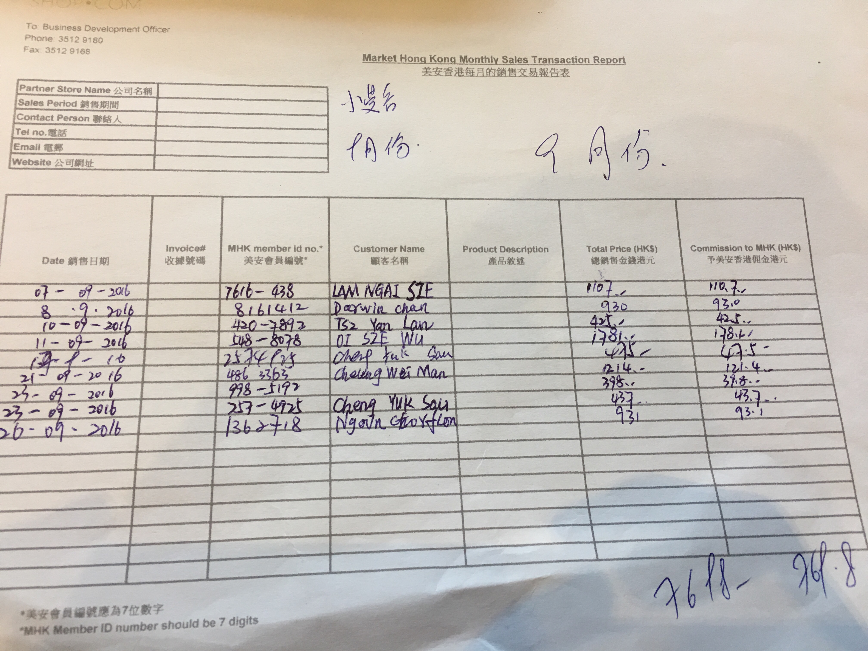
Can you accept this Transaction Report?
Transaction Report changed to digital format

Slide 8
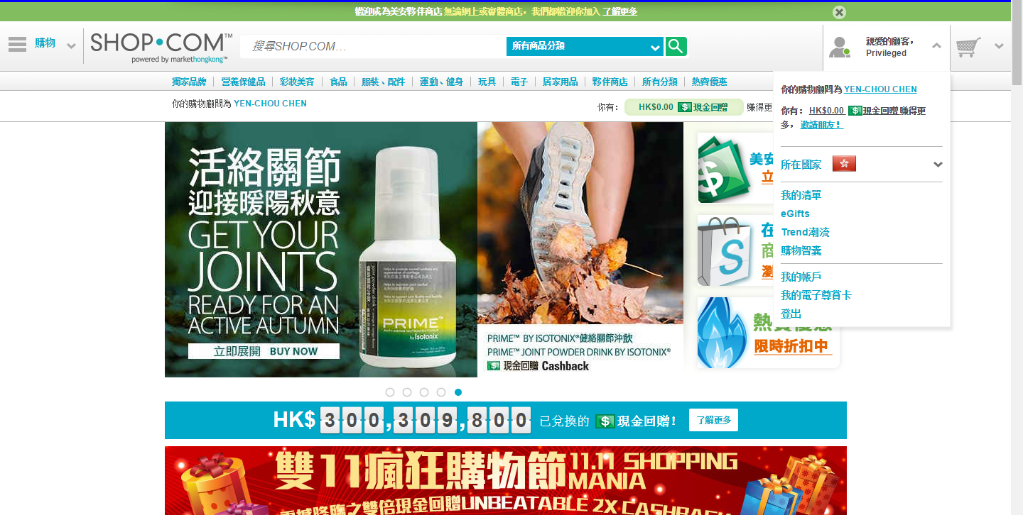

Slide 10
Welcome
E-mail

Slide 11
Partner Store
Merchant Apps
Coming Soon!

Slide 12
Partner Store Sticker will be placed outside of the retail-store of Partner Store
Notes:
Partner Store Sticker will be placed in Store

Slide 13
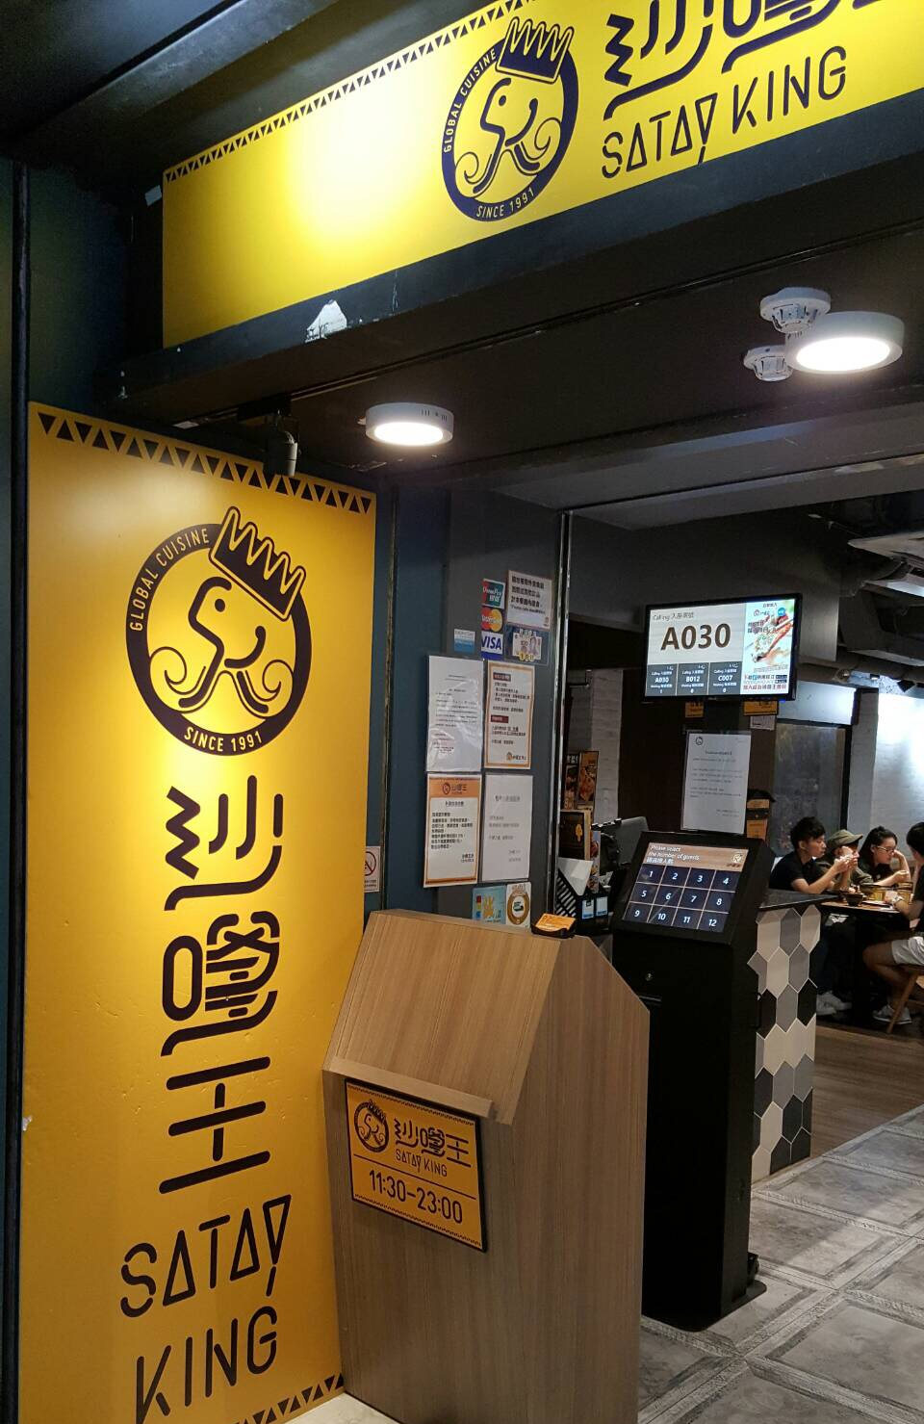
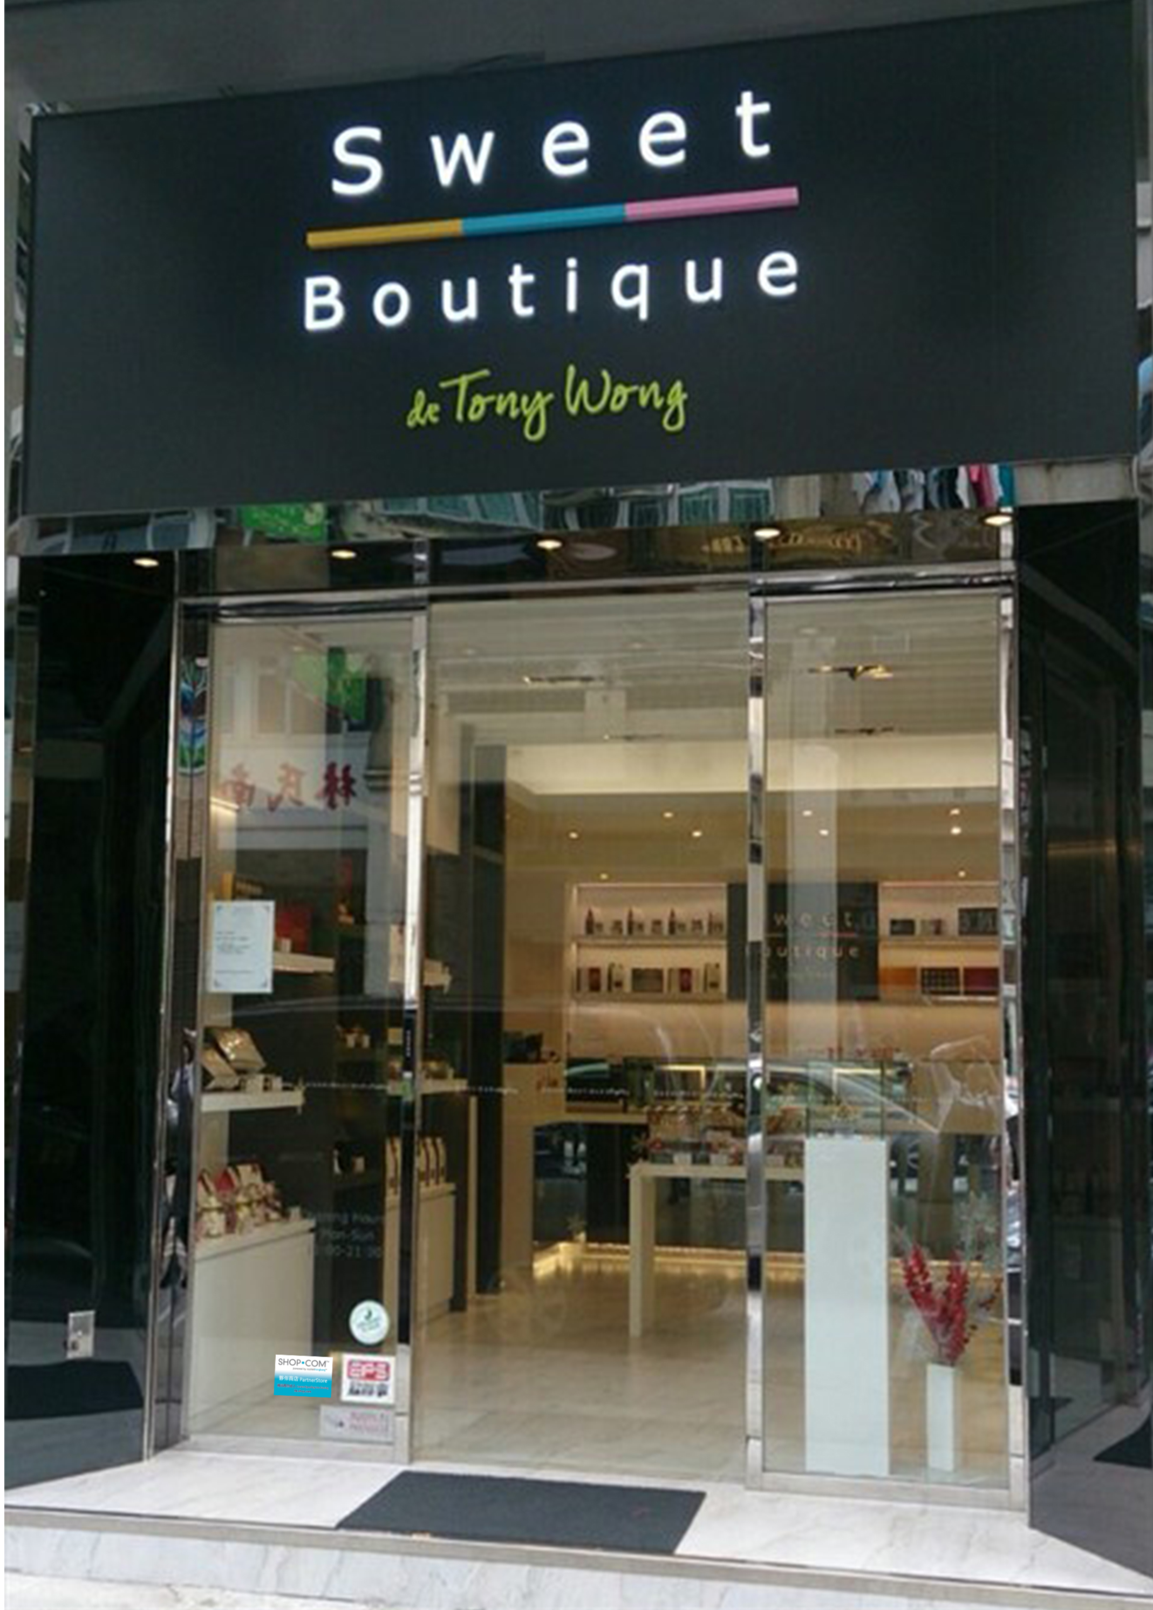
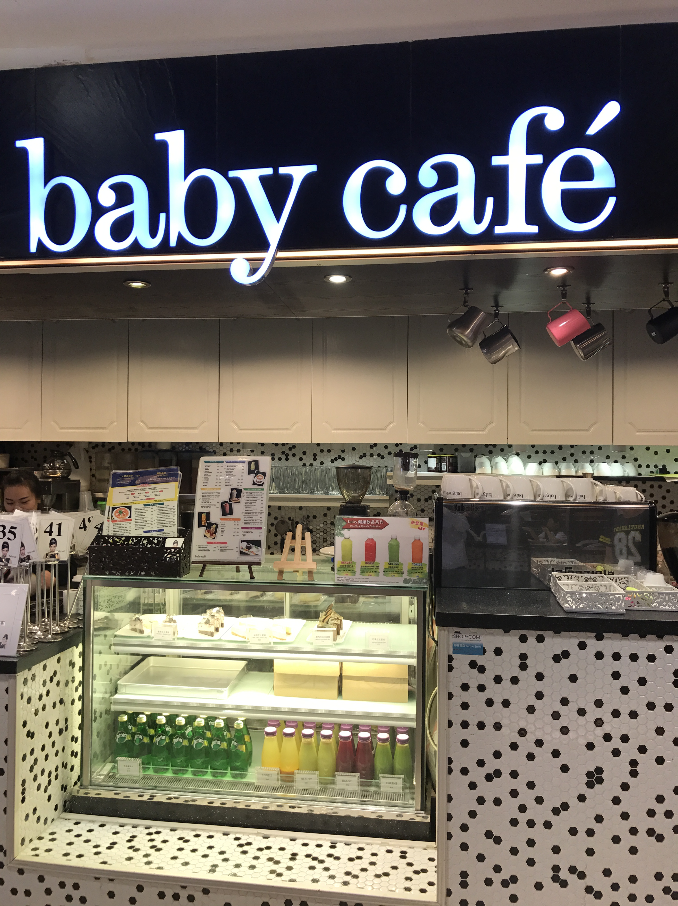

Slide 14
Emmanuel f. is a professional beauty salon, specializing in the use of natural and organic products.
Designed to provide recyclable furniture, so that customers are in a natural relaxed and comfortable environment, enjoying quality service.

Slide 15
HKLS 2016 Exclusive offer
MHK members enjoy exclusive 30% off for Hair & Spa services by showing Leadership School ticket stub (Nails & Waxing excluded)
Each person must present the ticket to redeem the discounts
Monday to Thursday only
3. This discount can not be used in any conjunctions of promotion, discounts and memberships
4. Valid till 28 Feb 2017

Slide 16
Market Hong Kong 2016 (Jan-Aug)
The Highest Sales of Local Partner Store in Restaurant Category

Slide 17
Market Hong Kong 2016 (Jan-Aug)
The Highest Sales of Local Partner Store in Electronic Category

Slide 18
Market Hong Kong 2016 (Jan-Aug)
The Highest Sales of Local Partner Store in Apparel & Beauty Category

Slide 19
Market Hong Kong 2016 (Jan-Aug)
The Highest Sales of Local Partner Store in Service Category

Slide 20
Market Hong Kong 2016 (Jan-Aug)
The Highest Sales of Local Partner Store in Health Category

Slide 21
What are the Popular Brands of
Partner Stores which will be joining?

Slide 22
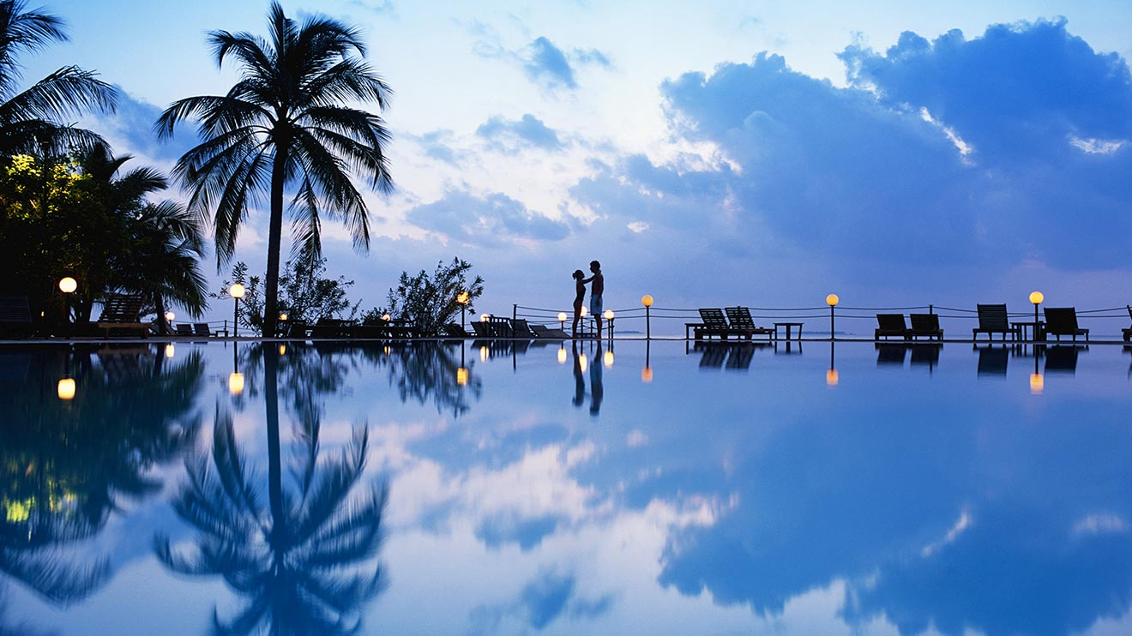
[Online Shop]
One-stop online travel agency service platform
Offering more than 282,000 hotels, 400 airlines and free-lane packages

Slide 23
[Online Shop]
The world's senior market leader glasses, is also the world's highest-selling glasses so far brand.
Ray-Ban Hong Kong official online shop to purchase any type grid sunglasses, optional different models, lenses

Slide 24
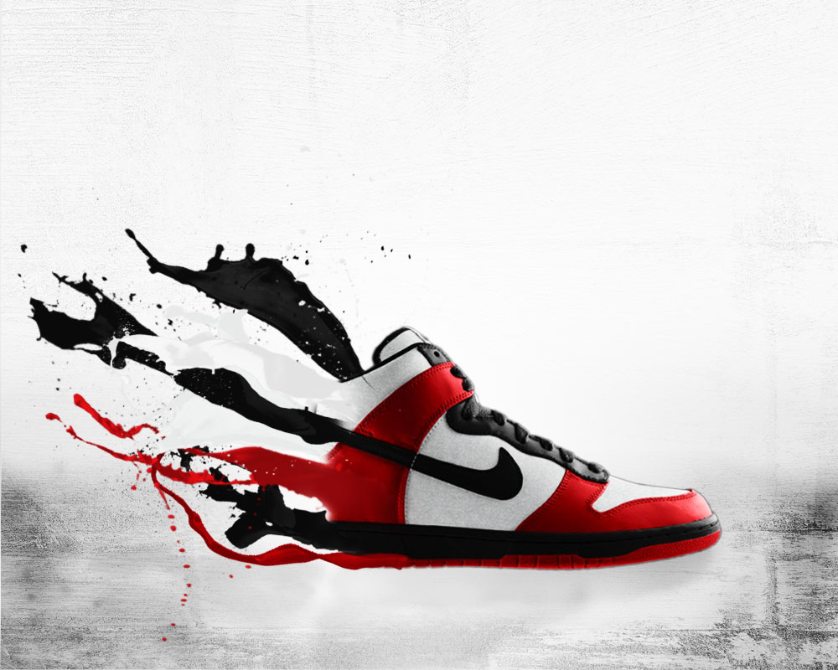
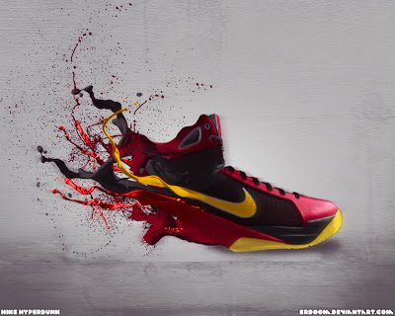
[Online Shop]
The world's leading sports brand
The main production of sports shoes, sportswear, sporting goods, with their own brand sales, including Nike, Air Jordan, Nike Golf, Team Starter

Slide 25
[Online Shop]
Asian cosmetics retail industry leader. To "one-stop cosmetics store" concept, SaSa provides customers with a wide range of quality products.
Offering more than 700 branded products, in totally more than 17,000 products, including skin care products, perfumes, cosmetics, hair care and body care products, beauty nutrition food, as well as exclusive brands and exclusive brand-name products

Slide 26
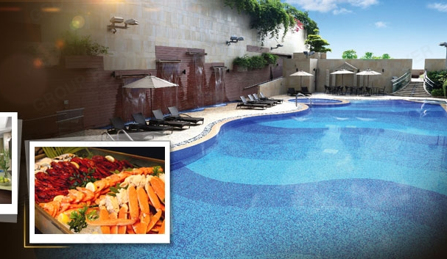
[Online Shop]
Harbour Plaza 8 Degrees is under Harbour Plaza Hotels and Resorts
Designs that delight your senses – intimate rooms, luxury hotel suites, a stunning lobby, distinctive restaurants and bar, multi-purpose function rooms and extraordinary facilities – blending comfort, style and convenience.

Slide 27
HKLC 2016 Exclusive offer
Coming Soon
8 Degree Café (Lobby)
All-You-Can-Eat Dim Sum Lunch Buffet (Monday – Friday, except public holiday) : 20% discount off
Afternoon Tea Set : 20% discount off
A la carte Lunch Menu : 15% discount off
Mango Napoleon 1lb Whole Cake : : 15% discount off
*Valid until 31 Mar 2017
3% Cashback
4% IBV
Notes:
Café 8 Degrees (G/F)
All-You-Can-Eat Dim Sum Lunch Buffet (Monday – Friday, except public holiday) 20% discount
Afternoon Tea Set 20% discount
A la carte Lunch Menu 15% discount
Mango Napoleon 1lb Whole Cake 15% discount

Slide 28
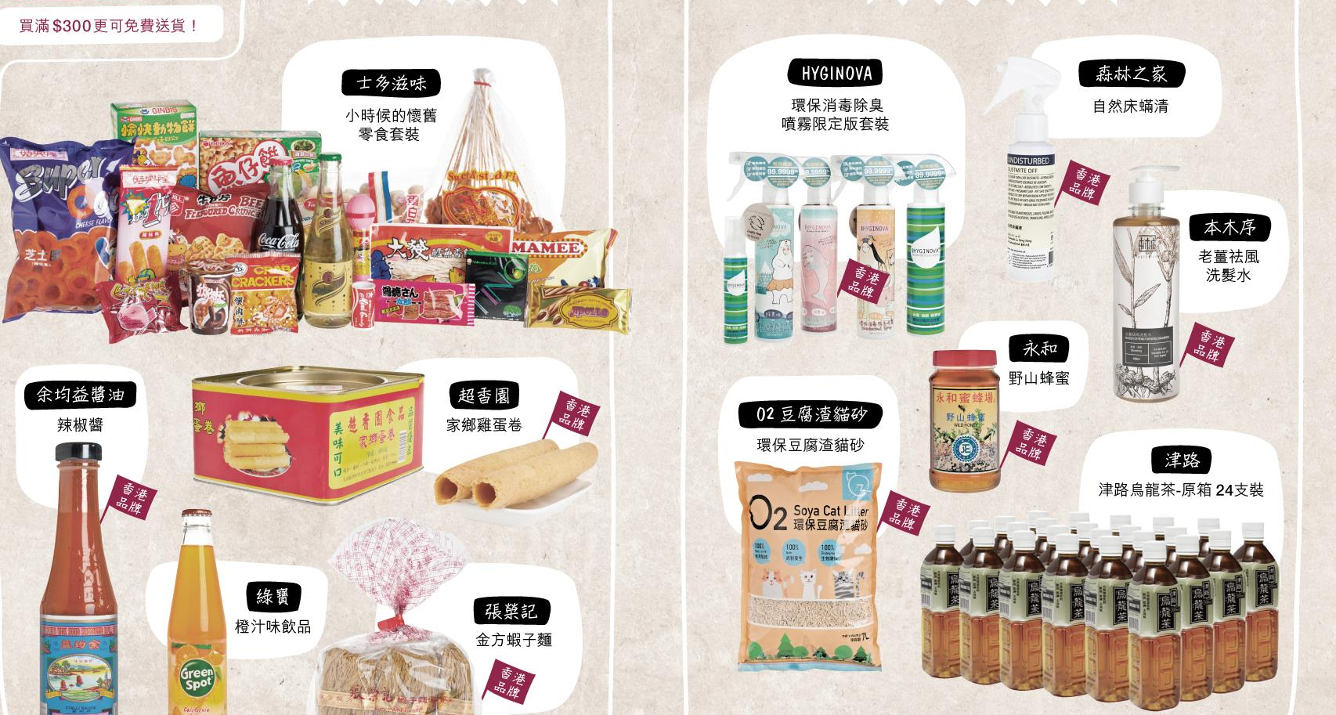
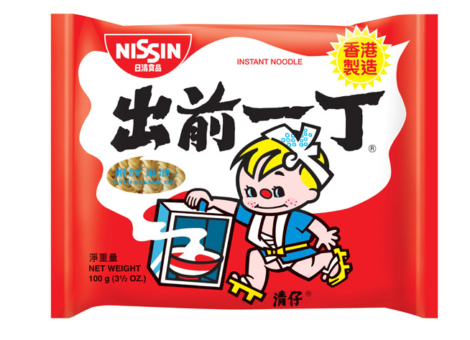

Slide 29
[Online Shop]
Online supermarket with same-day delivery, selling quality groceries and home essentials.
You can simply buy what you want anywhere anytime online. Through the certificated payment gateway, you just choose your favorite delivery time slot and you will receive your delivery at home fast and safe.

Slide 30
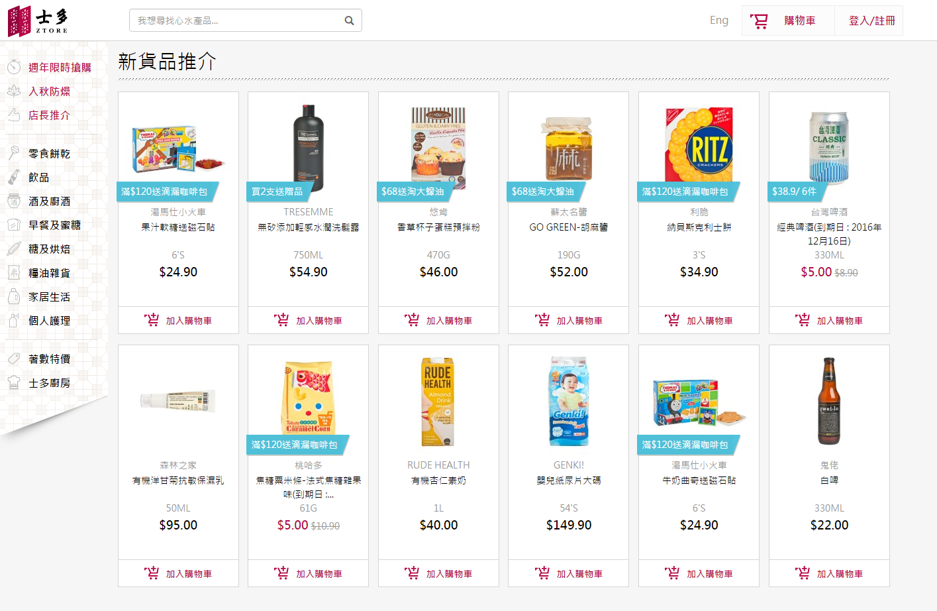

Slide 31
About ZTORE.com
Established in 2015, raised funding over $20 millions
The first online supermarket offer same-day delivery in Hong Kong
Deliver on the same-day from the central warehouse
May 2015
Established
Nov 2015
Official Launched www.ztore.com
Now
Team of 50+
Carry 6000+ products

Slide 32
Online Shop
超過6000種產品的
Free Delivery
Local Brand
Over 6000 products!
Free Same-day delivery for purchase over $300!
Made in Hong Kong!

Slide 33
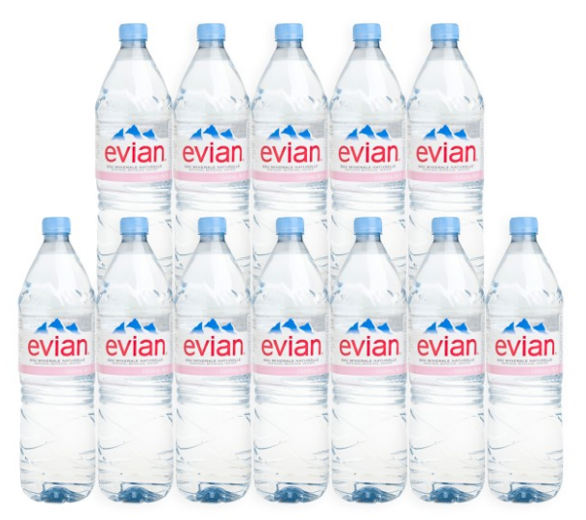
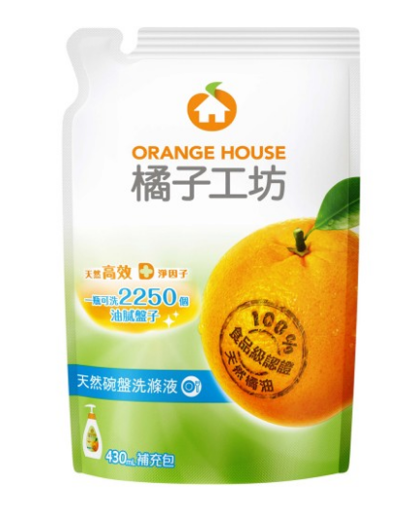
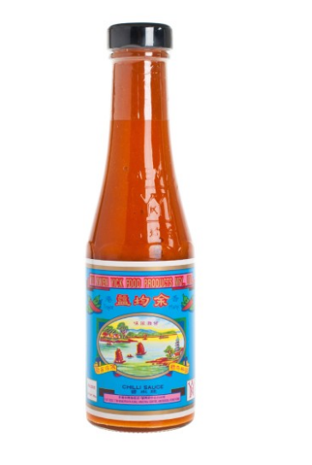
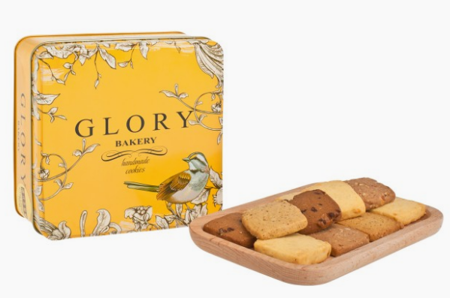
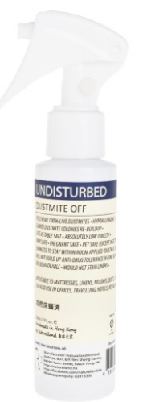
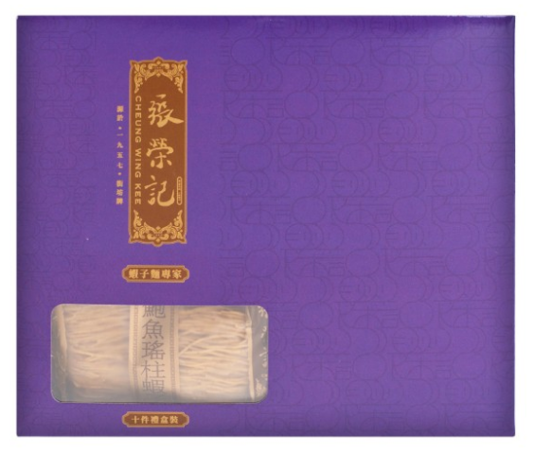
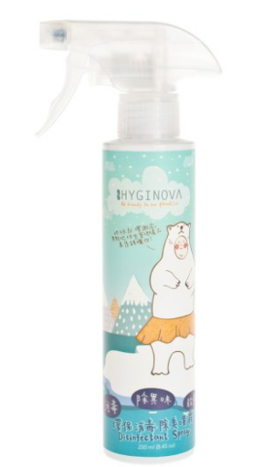
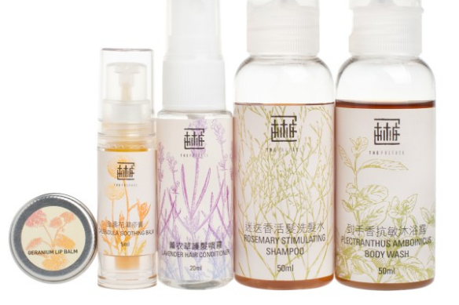
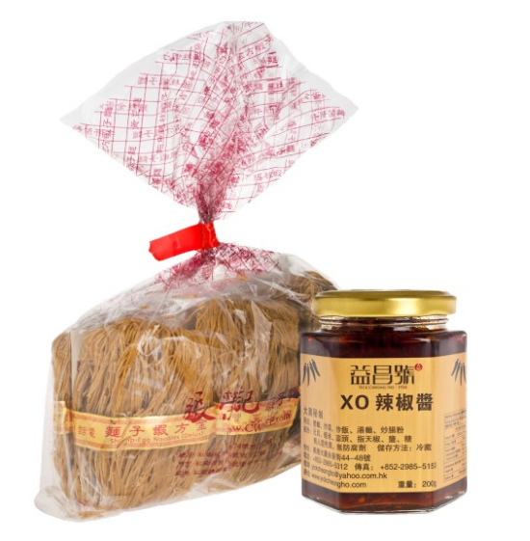
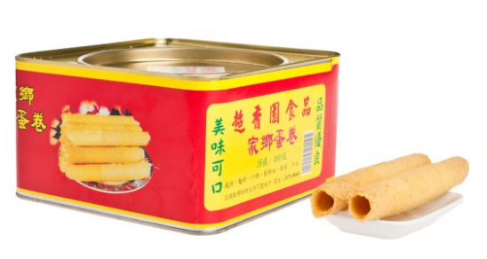
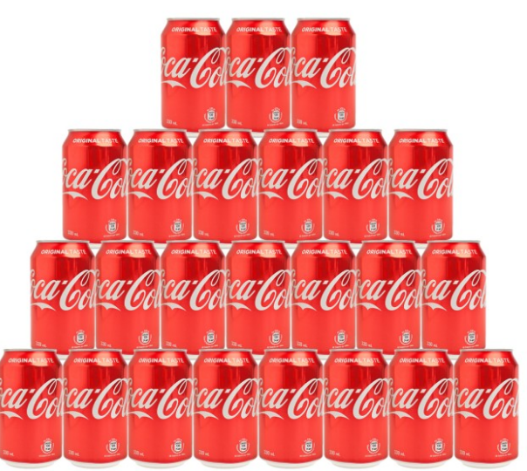
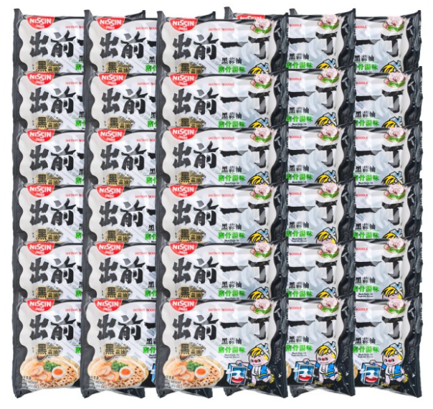
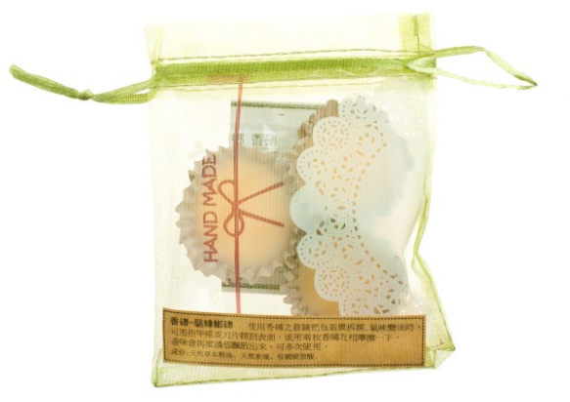
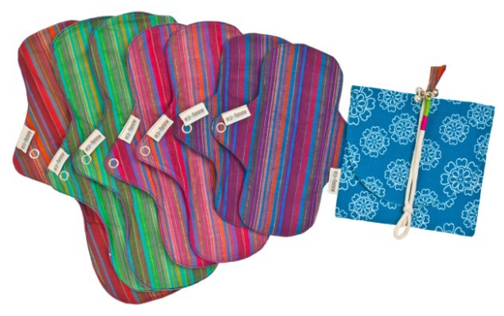
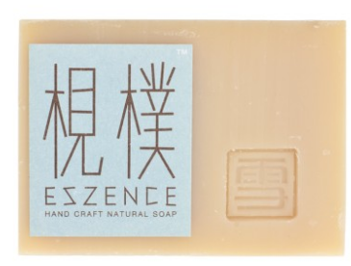
ZTORE PRODUCTS
MASS BRAND
Grocery
Snack & Biscuit
Beverage
Alcohol
Breakfast
Baking Needs
Home & Family
Personal Care
SPECIAL ON ZTORE
Eco-friendly
cleaning supplies
Handmade/eco-friendly body care
Made in HK
Local Bakery
Local Brew
Case Offer

Slide 34
HKLS 2016 Exclusive offer

Slide 35
1. Just continue what you normally do every day
2. Earn Cashback
3. Accumulate BV & IBV
4. Achieve SABP
5. Convert Spending into Earning
Remember, Shopping is happy

Slide 36
Special thanks to the following Partner Store for gifts sponsors

